Slide 1
Support Vector Machine
Dr. Rashmi Mahajan

Slide 2
Types of Machine Learning
Supervised Learning – The learning is contained in a controlled way to oversee the outcome accordingly. It is as the name suggest supervised in a way the machine learns what the user wants it to learn.
Unsupervised Learning – In this case, the machine simply explores the data given to it. The data is sometimes, unlabeled and uncategorized and the machine makes the possible references and predictions without any supervision.
Reinforcement Learning – It basically means to enforce a pattern of behavior. The machine needs to establish a systematic pattern of approach in reinforcement learning.

Slide 3
Support Vector Machine
Supervised (inputs and output will be known)
Classification (sigmoid function)
Regression (Linear)
May fit into the both

Slide 4
Support Vector Machine
A Support Vector Machine was first introduced in the 1960s and later improvised in the 1990s. It is a supervised learning machine learning classification algorithm that has become extremely popular nowadays owing to its extremely efficient results.
An SVM is implemented in a slightly different way than other machine learning algorithms. It is capable of performing classification, regression and outlier detection.
Support Vector Machine is a discriminative classifier that is formally designed by a separative hyperplane. It is a representation of examples as points in space that are mapped so that the points of different categories are separated by a gap as wide as possible. In addition to this, an SVM can also perform non-linear classification. Let us take a look at how the Support Vector Machine work.

Slide 5
Support Vector Machine
The main objective of a support vector machine is to segregate the given data in the best possible way.
Used to create best line or decision boundary-----hyperplane
SVM choose the points ----- create hyperplane

Slide 6
Applications of SVM
Face detection
Image classification
Text categorization

Slide 7
Types
Linear SVM
Non-linear SVM

Slide 8
Support Vector Machine
Hyperplane
Support Vector
How SVM works
Optimization Objective
Maximum margin principal

Slide 9
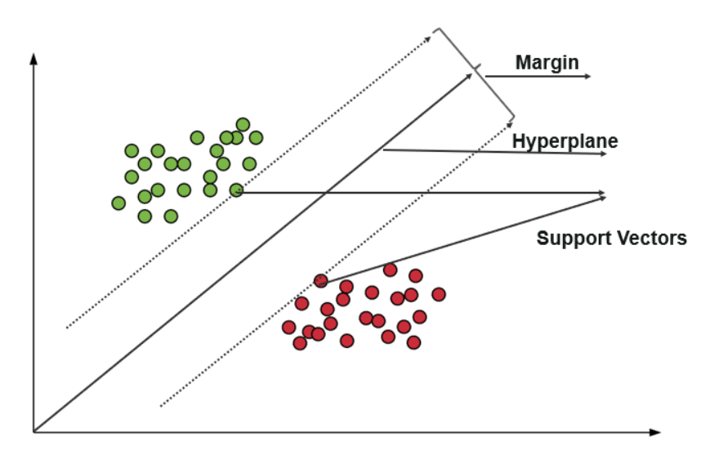










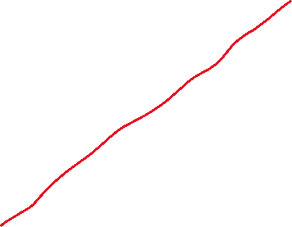




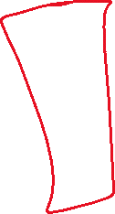



Slide 10
Support Vector Machine
In some cases, hyperplanes can not be very efficient.
In those cases, the support vector machine uses a kernel trick to transform the input into a higher-dimensional space.
With this, it becomes easier to segregate the points. Let us take a look at the SVM kernels.

Slide 11
Support Vector Machine- Application
The goal of this example is to classify cricket players into batsmen or bowlers using the runs-to-wicket ratio. A player with more runs would be considered a batsman and a player with more wickets would be considered a bowler.

Slide 12
Support Vector Machine- Application
If you take a data set of cricket players with runs and wickets in columns next to their names,
you could create a two-dimensional plot showing a clear separation between bowlers and batsmen.
Here we present a data set with clear segregation between bowlers versus batsmen to help understand SVM.

Slide 13
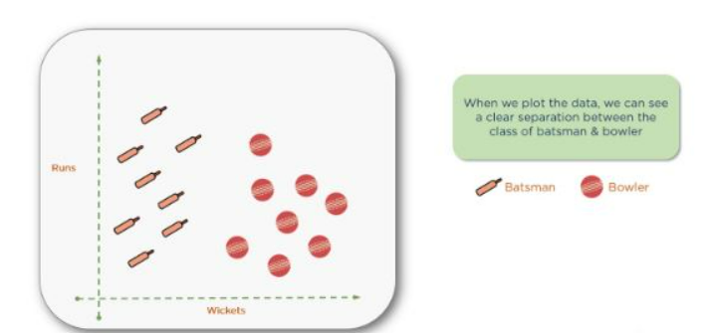
Support Vector Machine- Application

Slide 14
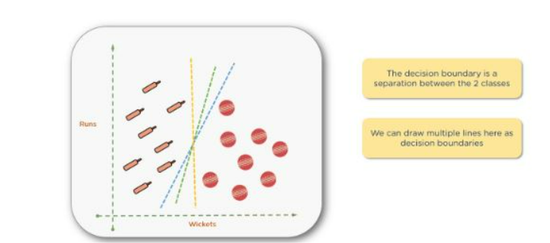
Support Vector Machine- Application

Slide 15
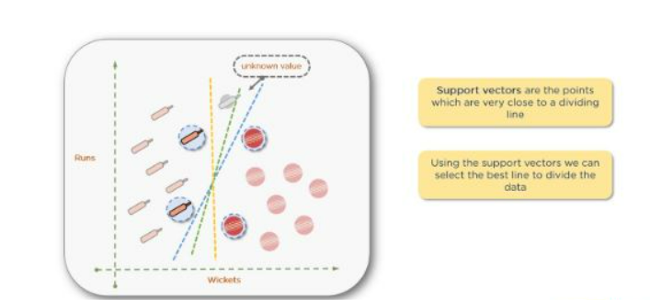
Support Vector Machine- Application

Slide 16
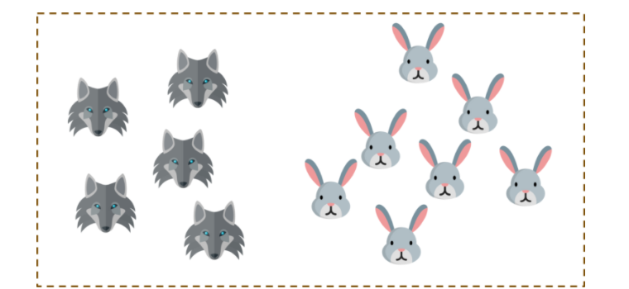


Support Vector Machine- Application

Slide 17
Support Vector Machine- Application
you need to set up a fence to protect your rabbits from a pack of wolves.

Slide 18
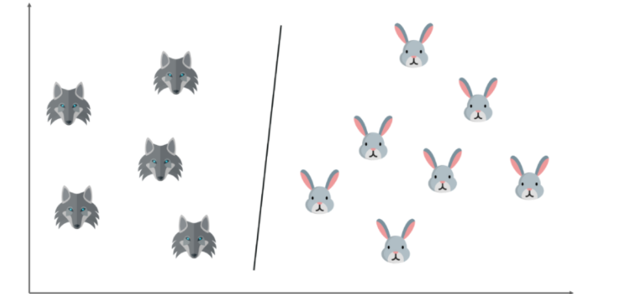
Support Vector Machine- Application
and try to draw a decision boundary between the rabbits and the wolves, it looks something like this. Now you can clearly build a fence along this line.

Slide 19
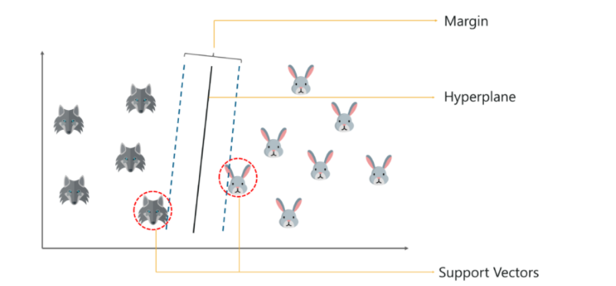
Support Vector Machine- Application
you start of by drawing a random hyperplane and then you check the distance between the hyperplane and the closest data points from each class. These closest data points to the hyperplane are known as support vectors. And that’s where the name comes from, support vector machine.

Slide 20
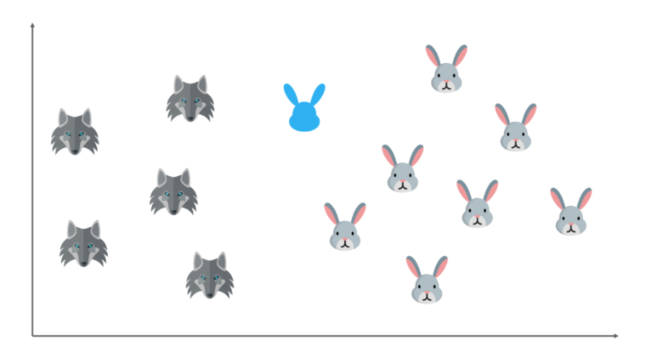
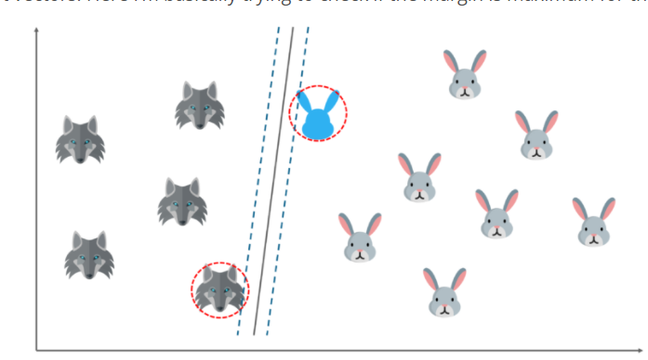

Slide 21
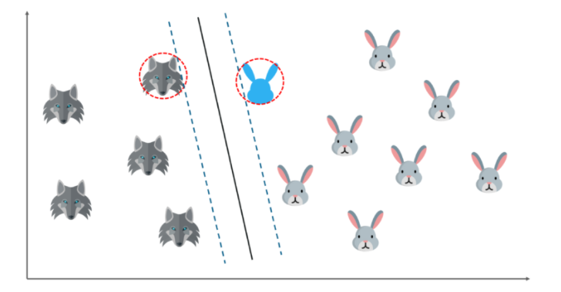

Slide 22
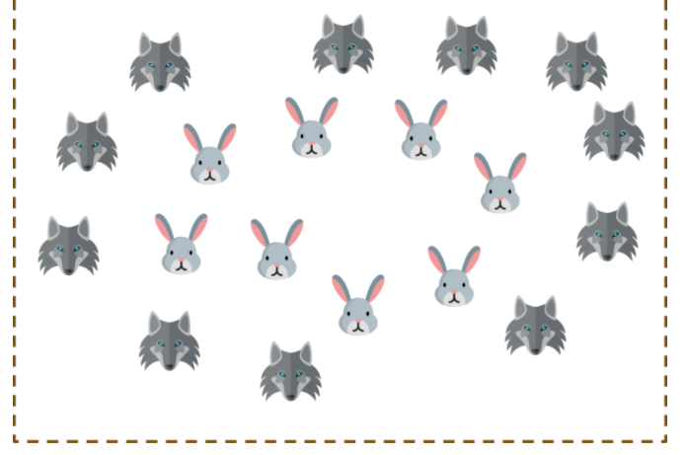
Support Vector Machine- Application

Slide 23
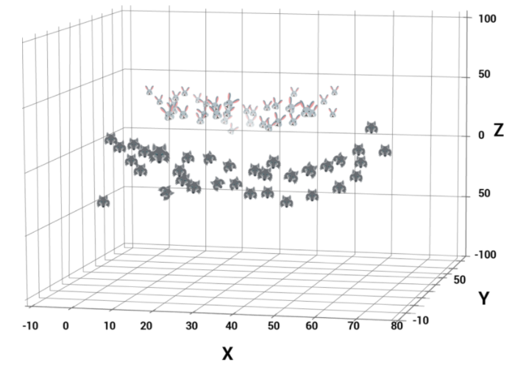
Support Vector Machine- Application(non linear)

Slide 24
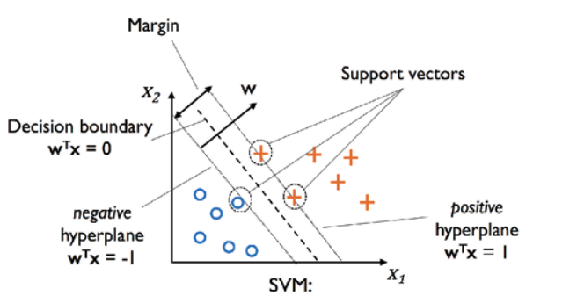
Support Vector Machine- Vectors

Slide 25
Support Vector Machine
Support Vector
Hyperplane
Kernel Function

